Slide 1
Image Classification using Neural Networks

Slide 2
Outline
Project Purpose
Project Goal
Preprocess of Image Data
Models
Baseline Neural Network
Improvements
Tuned Neural Network
Sample Images
Website Deployment
Stretch Goals

Slide 3
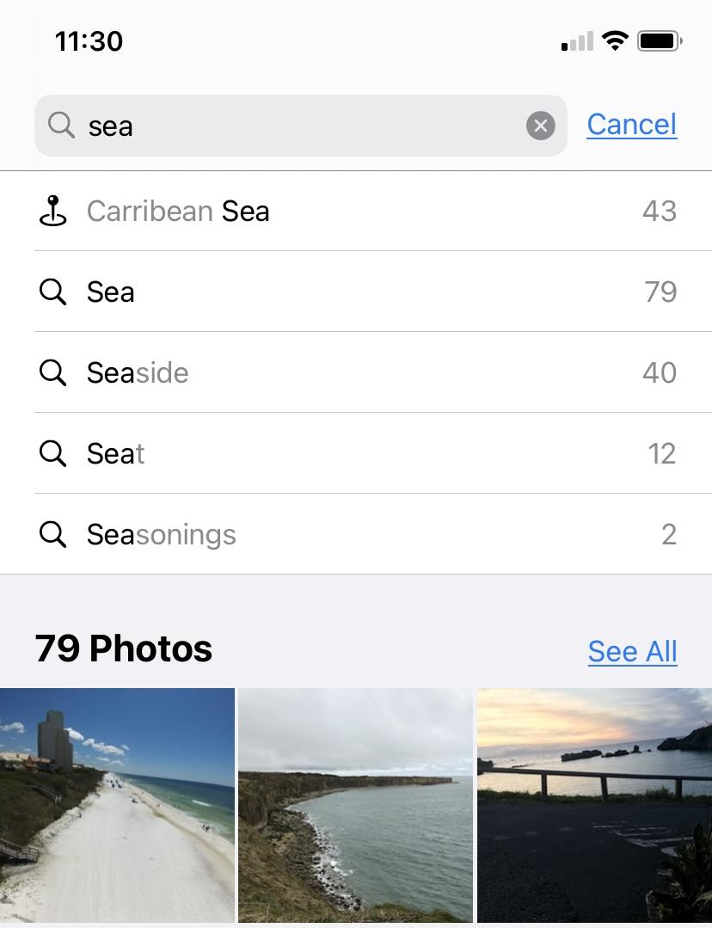
Project Purpose:
1.0
The model could be implemented into any situation where landscape images need to be labelled.
Examples:
Tagging images in your camera roll into albums.
Presorting images into folders for Professional Photographers.

Slide 4
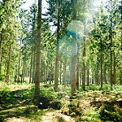
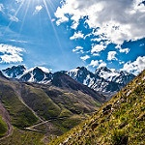
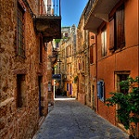
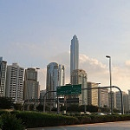
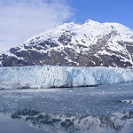
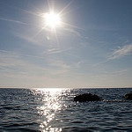
Project Goal
1.1
The data used to train our model consists of 14,034 training and 3,000 testing images with the goal being to train a model that can classify a new image into one of the following six categories:
Buildings
Glaciers
Seas
Forests
Mountains
Streets
Notes:
Use case 1st
14034 for training 3000 testing

Slide 5
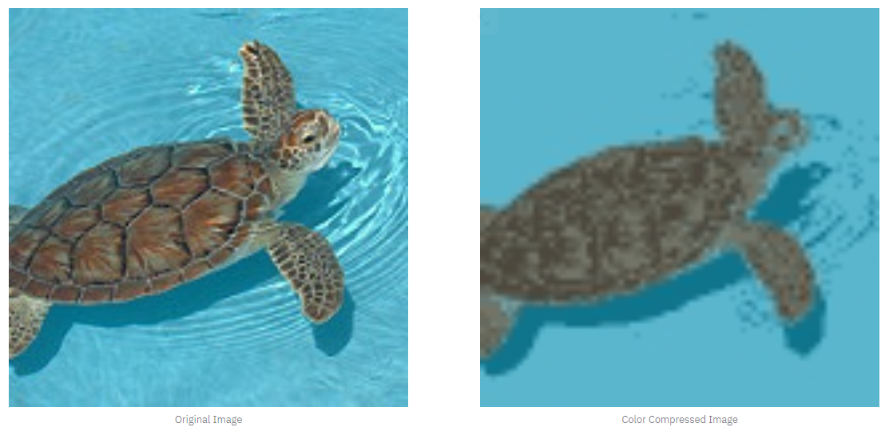
Preprocessing
2.0
Utilized provided train-test sets
Normalizing
Scaling to ¼ size
Color Compression
Notes:
To get started, we loaded in the training and testing images(14,000 train and 3000 test) and then normalized the pixel values to be between 0 and 1.
The images had dimensions of 150 pixels square and 3 color dimensions for red, blue, ad green.
With initial testing, our models ran very slowly on data this large. We decided to reduce the color space in the images and scaled the images down to a quarter of their original size having final dimensions of 75 pixels square.
Josh can discuss how the color compression is done if a question is asked.

Slide 6
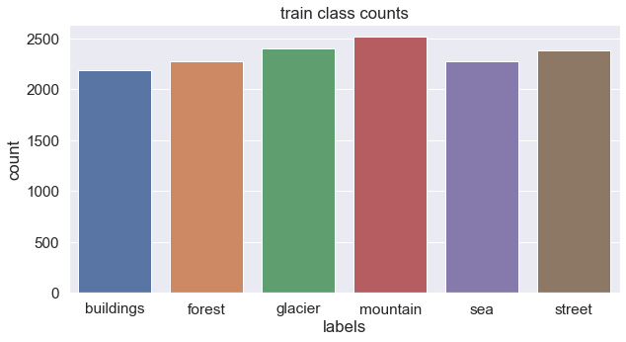
Training Class Imbalance
2.1

Slide 7
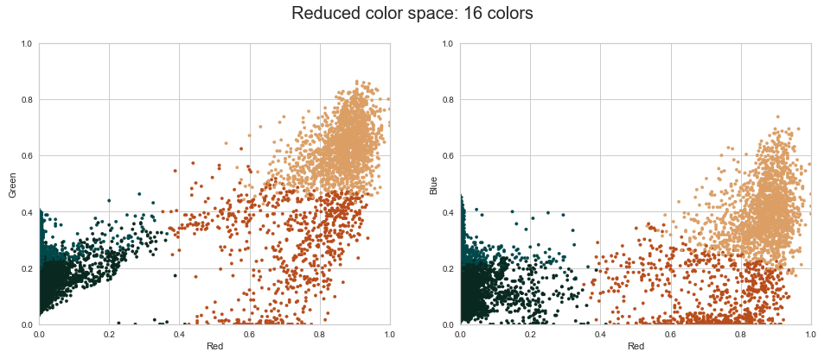
Color Compression -
Deeper explanation:
2.2
Notes:
Here we look into how KNN Mean Clustering reduces the amount of information the Neural Network has to work through. Each pixel array is averaged to the nearest centroid of a preset number, for our model 4 centroids were used. Then the new value is used to create a color reduced image as seen previously.

Slide 8
Outline
Project Purpose
Project Goal
Preprocess of Image Data
Models
Baseline Neural Network
Improvements
Tuned Neural Network
Sample Images
Website Deployment
Stretch Goals

Slide 9
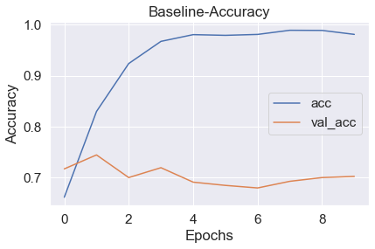
Baseline
3.1
Convolutional Neural Network
Five Layers
Result
30% Difference
Overfitting
Notes:
The baseline model uses five layers in total. The accuracy on the validation data was about 70%, but the model was very overfit as seen by the large difference in train and validation accuracy.
Model Structure:
Model: "sequential_1"
_________________________________________________________________
Layer (type) Output Shape Param #
=================================================================
conv2d_2 (Conv2D) (None, 148, 148, 64) 1792
_________________________________________________________________
max_pooling2d_1 (MaxPooling2 (None, 74, 74, 64) 0
_________________________________________________________________
flatten_1 (Flatten) (None, 350464) 0
_________________________________________________________________
dense_2 (Dense) (None, 128) 44859520
_________________________________________________________________
dense_3 (Dense) (None, 6) 774
=================================================================
Total params: 44,862,086
Trainable params: 44,862,086
Non-trainable params: 0

Slide 10
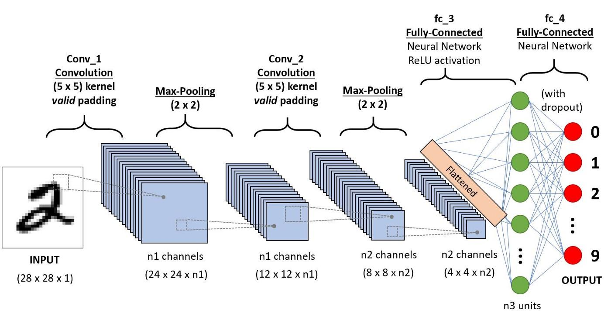
CNNS
3.2
Notes:
A Convolutional Neural Network is a Deep Learning algorithm which can take in an input image, assign importance through learnable weights and biases to various aspects of the image and be able to differentiate one from the other. Each image had a pixel structure of 150 x150x3.
Pixels split into 3 rgb layers, so 17,000 images with 150x150 pixels x 3 layers is a lot of pixels. CNNs help to reduce the images into a form which is easier to process, without losing features that are critical to getting a good prediction. Image matices are passed through a filter to extract the important feature. The new values then go through a pooling layer to reduce dimensionality. The matrices are then flattened and passed into a normal neural network. Finally, with back propagation, the filter values are adjusted to minimize the cost function.

Slide 11
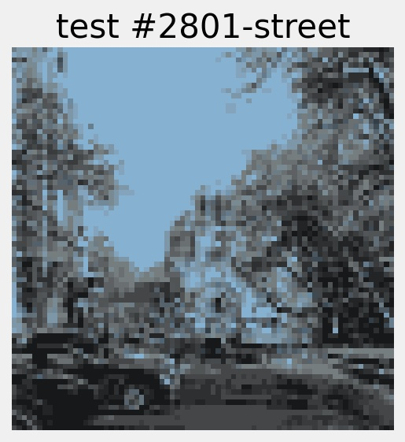
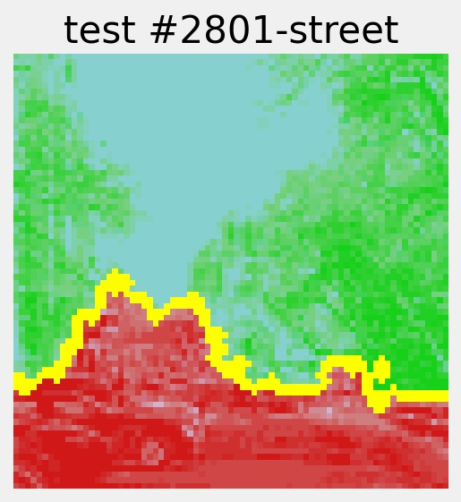
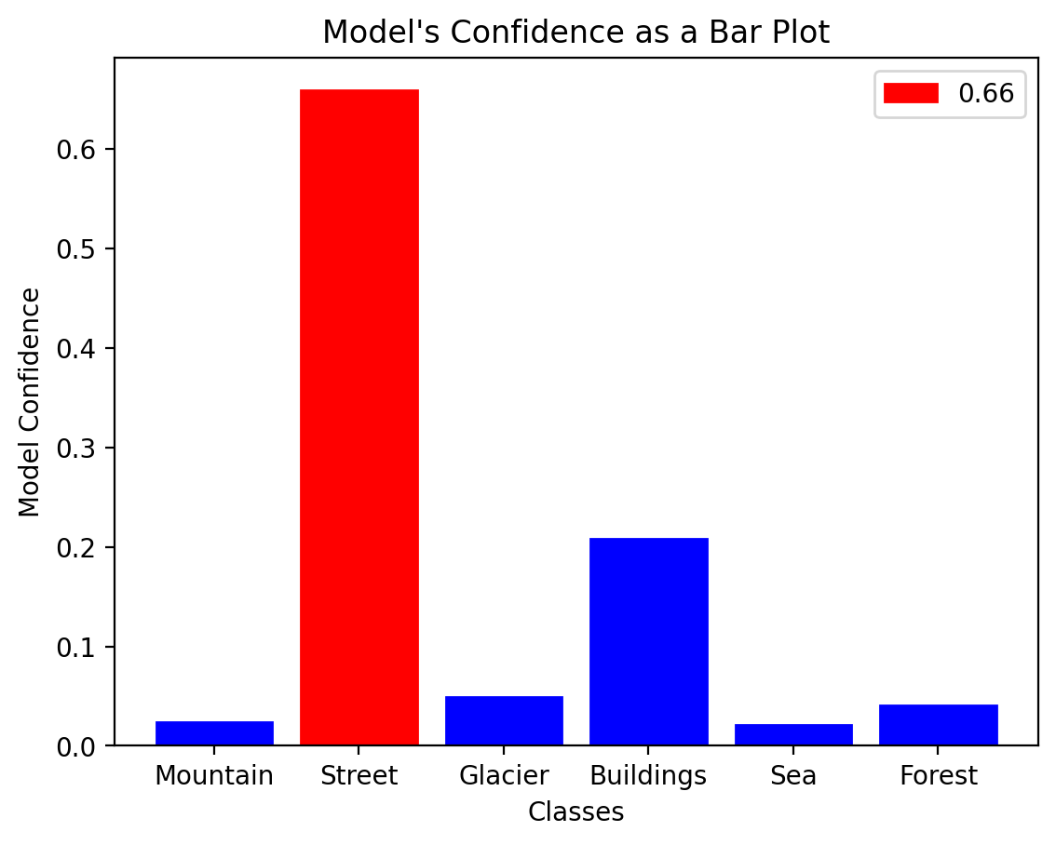
Improvements
3.1.i
Regularization
Dropout layers
Notes:
We used regularization and dropout layers in out model to reduce overfitting to the training data. Regularization applies penalties to model parameters that are very confident and dropout layers will turn off random nodes within some model layers.
We also used a model explainer called LIME as a tool to see what parts of the pictures are most important.
LIME stands for ‘local interpretable model agnostic explanations which means that is can help interpret any type of model.
LIME will return the picture given to the model with edges drawn to visualize where the model finds meaning.
In this example of a street, the top part of the image in green contributed the the model predicting street. The part in red threw the model off and steered it towards predicting a building.
Change line graphs to bar graphs #’s 2801, 1777, 1273
Questions:
LIME stands for:
local interpretable model-agnostic explanations

Slide 12
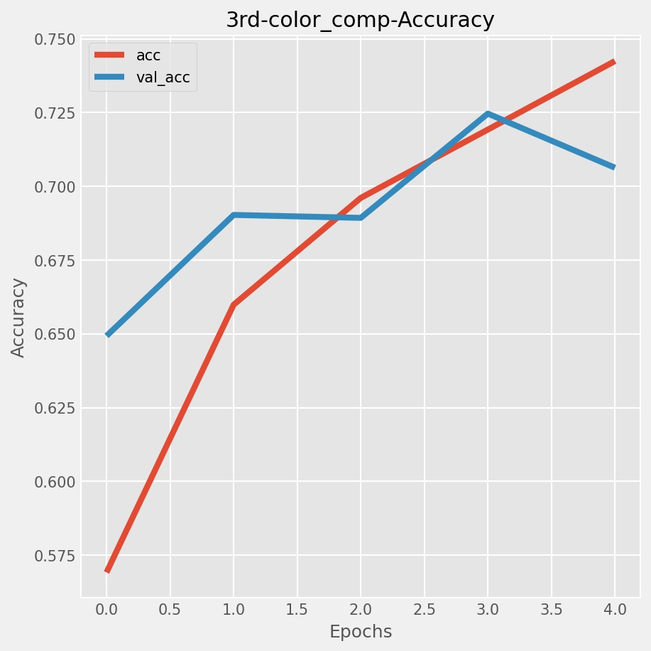
Final Model
3.2
7 Layers
Tuned L2 Regularization
Dropout
Result
3% difference
~70% Accurate
Notes:
In our final model, we fine-tuned the regularization and dropout and created additional layers for the model. After five training cycles, called ‘epochs’, the model’s accuracy was about 70% with fewer signs of overfitting as you can see by the lines being closer together. We could probably improve this model by training it longer and possibly adjusting the regularization more to limit overfitting in later epochs.
Model Structure:
Model: "sequential_12"
_________________________________________________________________
Layer (type) Output Shape Param #
=================================================================
conv2d_34 (Conv2D) (None, 73, 73, 128) 3584
_________________________________________________________________
max_pooling2d_12 (MaxPooling (None, 36, 36, 128) 0
_________________________________________________________________
dropout_12 (Dropout) (None, 36, 36, 128) 0
_________________________________________________________________
conv2d_35 (Conv2D) (None, 34, 34, 128) 147584
_________________________________________________________________
flatten_12 (Flatten) (None, 147968) 0
_________________________________________________________________
dense_35 (Dense) (None, 128) 18940032
_________________________________________________________________
dense_36 (Dense) (None, 6) 774
=================================================================
Total params: 19,091,974
Trainable params: 19,091,974
Non-trainable params: 0

Slide 13
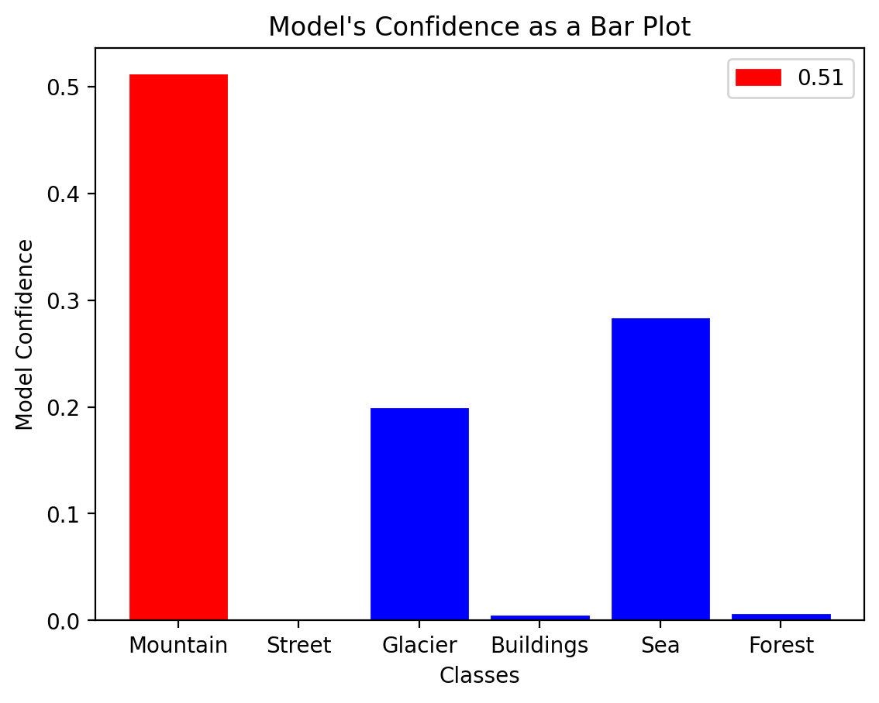
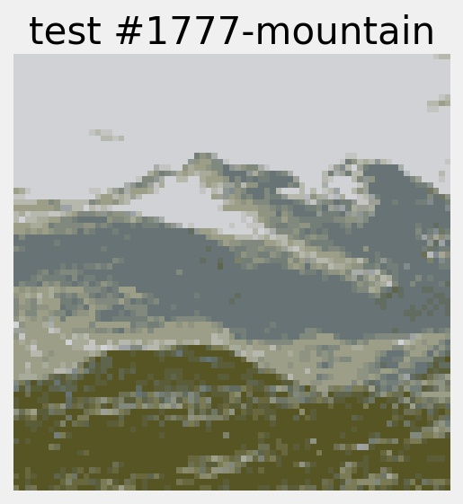
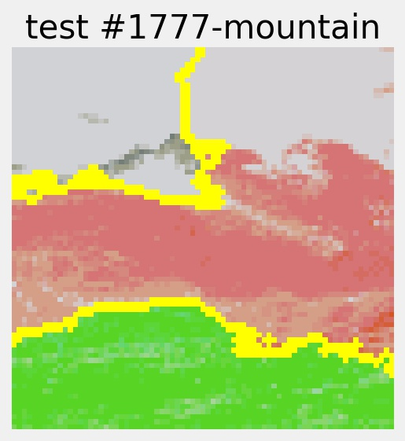
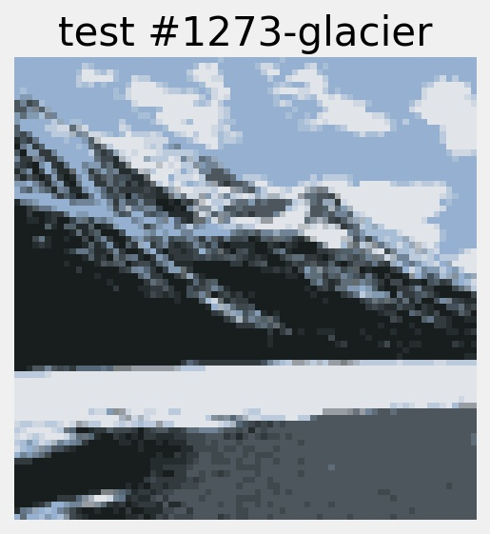
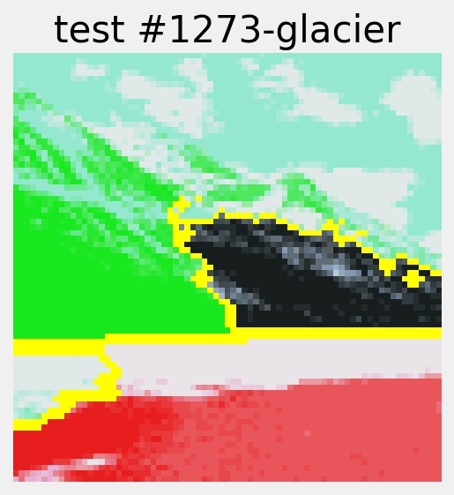
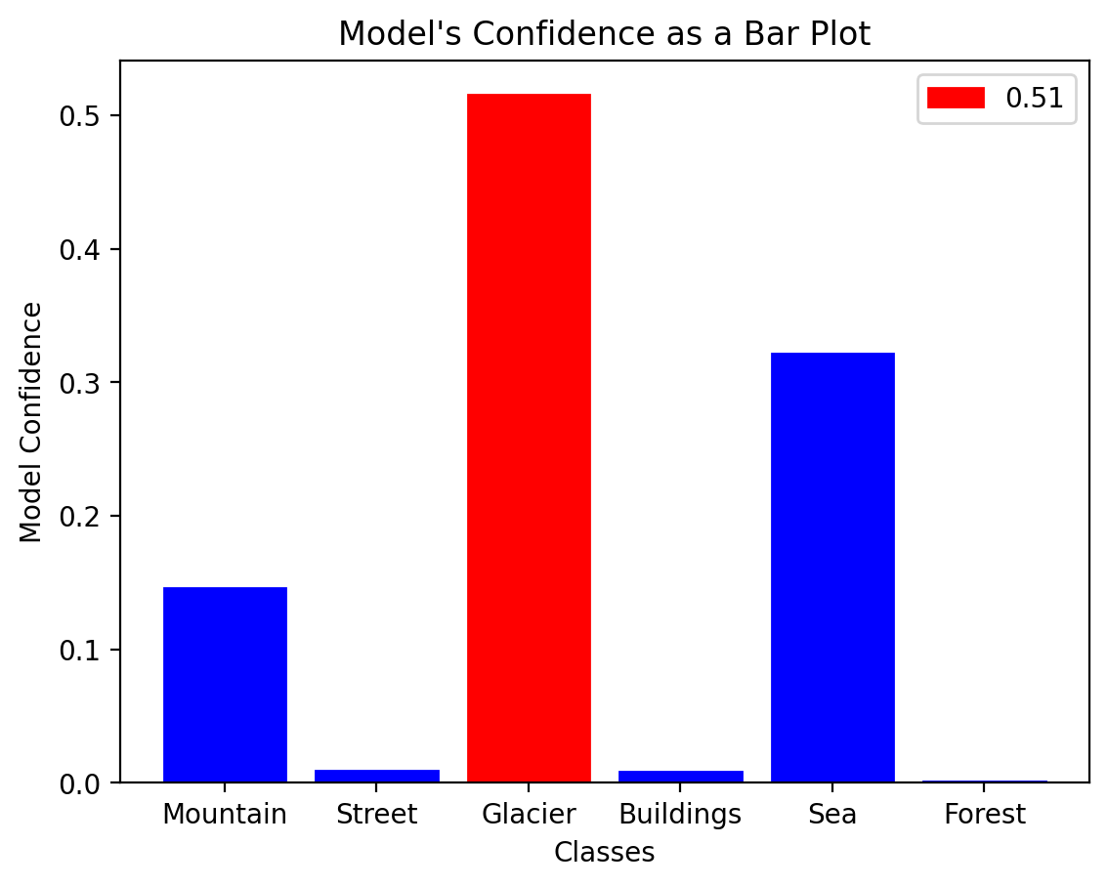
Sample
Images
3.2.i
Notes:
Here are some sample images given to the model. The first image is the original. The second is the output from the explainer and the last is the model’s predictions. The top picture is a mountain and the model correctly predicted it. The green on the middle image shows what parts of the picture positively affected the prediction and the red negatively affects the prediction. It looks like the model was tripped up by the snow on the peak and that's why it could have been a glacier.
The second image on the bottom was correctly predicted to be a glacier, but the model also predicted that it might be a sea.. The explainer image shows how the bottom edge of the picture looks like a shoreline, but ultimately, the model was more confident in it being a glacier.

Slide 14
Outline
Project Purpose
Project Goal
Preprocess of Image Data
Models
Baseline Neural Network
Improvements
Tuned Neural Network
Sample Images
Website Deployment
Stretch Goals

Slide 15
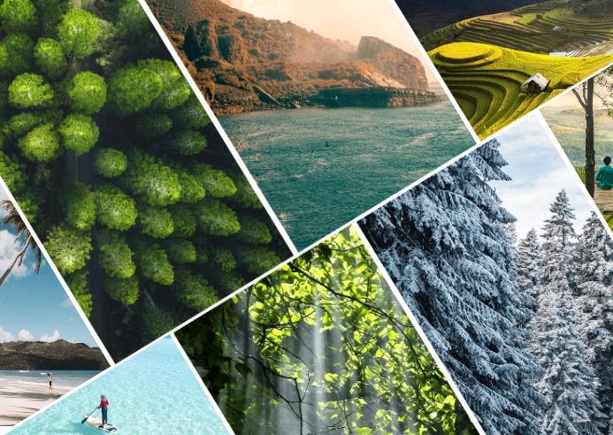
Image Classification
Demonstration
4.0
Notes:
http://localhost:8502/

Slide 16
Stretch Goals
5.0
More Accurate Model:
Currently we ran into computational limitation on running each model.
We could work with AWS or Google Colab to improve the speed of training these models.
Website improvements:
Allow the user to upload any image, currently they must come from the Kaggle Dataset for the website to work properly.
Add a model selector, more customizable graphs and/or a preloaded image library to pick from.
Research Image Classification Architecture:
Instead of guessing on how to structure each layer of our Neural Network, we could reference work such as Neural Network Architectures to improve our model’s performance.

Slide 17

Thank you
For Technical Notebooks,
Please View our Github Repository
Josh Hill
Email: Joshua.Hill7658@gmail.com
Github: Joshua-Hill-Science
Warren Umbach
Email: umbach4@gmail.com
Github: WarrenUm
Ross Richesin
Email: richesinrr0@gmail.com
Github: richesinrr0

